Slide 1

Python Programming Bootcamp - Week 2, Day 2
Loops – Introduction to for Loops
Atta Muhammad
attapanhyar@quest.edu.pk
+923331971110
Quaid e Awam University of Engineering, Science and Technology

Slide 2
Learning Objectives
Understand how for loops work in Python.
Learn the syntax of for loops and how to use them for iteration.
Explore practical uses of for loops to automate repetitive tasks.
Differentiate between while loops and for loops.

Slide 3
What is a for Loop?
Definition: A for loop is used to iterate over a sequence (such as a list, string, or range) and execute a block of code for each element in the sequence.
Why Use for Loops? Simplifies code when you need to repeat actions for every item in a sequence or range of numbers.

Slide 4


for Loop Syntax and Example
Syntax:
Example:

Slide 5
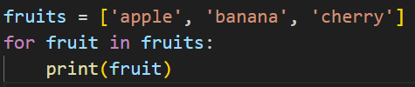
How for Loops Work
Visualize the Iteration:
The for loop picks the first item from the sequence, assigns it to the loop variable, runs the code, then moves to the next item in the sequence.
Example with a List:

Slide 6

The range() Function
What is range()? A function used to generate a sequence of numbers, commonly used in for loops.
range(start, stop, step)
start: The starting number (default is 0).
stop: The number at which the sequence stops (exclusive).
step: The increment between numbers (default is 1).

Slide 7
Hands-On Exercise 1
Task: Write a program that prints all numbers from 1 to 10 using a for loop and range().
Hint: Use range(1, 11) to include numbers from 1 to 10.

Slide 8

Looping Over Strings
Explanation: Strings are sequences, so you can use a for loop to iterate over each character in a string.
Example:

Slide 9

Looping Over Lists
Example:
Exercise: Modify the code to greet each city by adding the text "Welcome to" before the city name.

Slide 10
Hands-On Exercise 2
Task: Write a program that prints the square of every number from 1 to 10 using a for loop and range().
Hint: Use print(num**2) inside the loop.

Slide 11
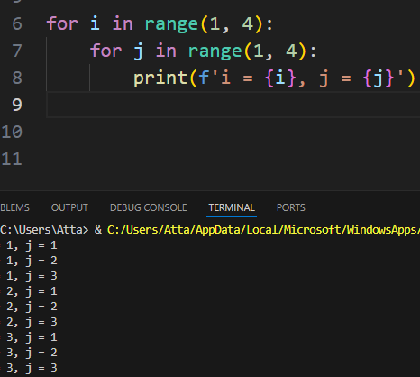
Nested for Loops
Explanation: You can place one for loop inside another to perform more complex tasks.
Example:

Slide 12
Comparing for and while Loops
while Loop:
A while loop runs while a condition is True.
It’s useful when you don’t know how many times you need to loop.
for Loop:
A for loop iterates over a known sequence or range.
It’s useful when you know how many times you want to iterate.

Slide 13
Comparing for and while Loops
while Loop:
A while loop runs while a condition is True.
It’s useful when you don’t know how many times you need to loop.
for Loop:
A for loop iterates over a known sequence or range.
It’s useful when you know how many times you want to iterate.

Slide 14
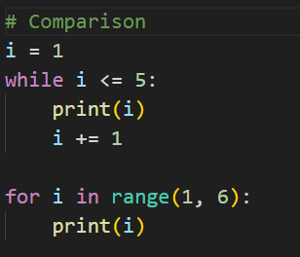
Comparing for and while Loops

Slide 15
Hands-On Exercise 3
Task: Write a program that prints the multiplication table for the number 5 (from 1 to 10) using a for loop.
Hint: Use for i in range(1, 11) and multiply i by 5 inside the loop.

Slide 16
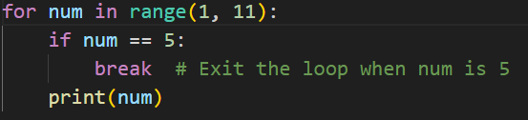
The break Statement in for Loops
Explanation: The break statement allows you to exit a loop before it has looped through all the items.
Example:

Slide 17
The continue Statement in for Loops
Explanation: The continue statement skips the rest of the current iteration and moves to the next iteration.
Example:

Slide 18
Hands-On Exercise 4
Task: Write a program that prints all odd numbers between 1 and 20 using a for loop and the continue statement.
Hint: Skip the even numbers using continue

Slide 19

Looping Over a Dictionary
Explanation: You can loop over dictionaries to access keys and values.
Example:

Slide 20
Group Activity
Task: Create a program that generates a list of 10 random numbers (between 1 and 100) and prints the sum and average of the numbers using a for loop.
Hint: Use sum() and len() to calculate the average after generating the list.

Slide 21
Common Mistakes in for Loops
Forgetting to update the loop variable:
In cases where a manual update is needed (like in custom ranges), ensure that the loop variable is updated.
Infinite loops: Avoid creating infinite loops with incorrect ranges or loop conditions.

Slide 22
Recap and Key Takeaways
Key Takeaways:
for loops are powerful for iterating over sequences like lists, strings, and ranges.
Use range() to generate sequences of numbers.
break and continue statements allow for more control within loops.
Nested for loops can be used for multi-dimensional tasks.
Next Session: Combining for loops with other structures like lists, dictionaries, and functions.

Slide 23
Q&A and Wrap-Up
Any questions or clarifications.
Recap

Slide 24
MATCH THE SOLUTION 😒

Slide 25
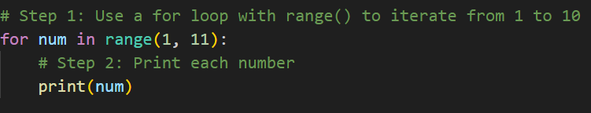
Exercise 😉

Slide 26
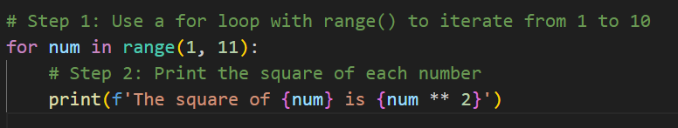
Exercise 🤷‍♂️

Slide 27
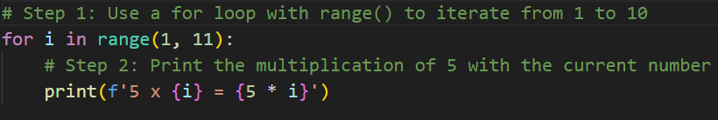
Exercise 🤗

Slide 28
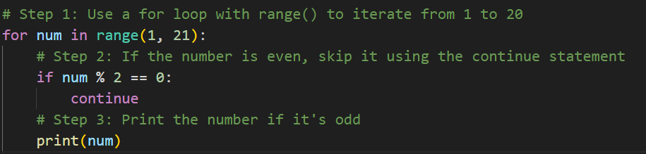
Exercise 🤐

Slide 29
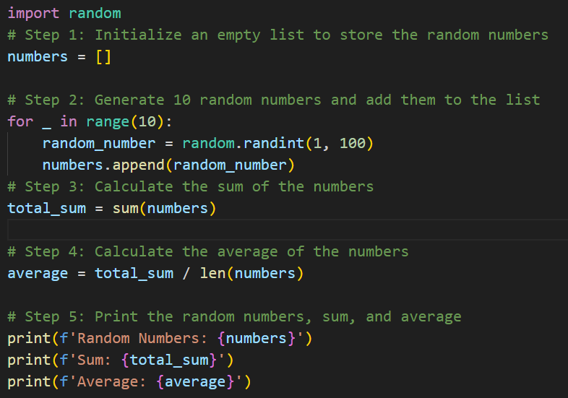
Exercise 💎

